Slide 1


Beer Data Analysis
Analyzing Beer data and creating a machine learning algorithm to help users make the decision which beer they should get based on flavor profiles.

Slide 2
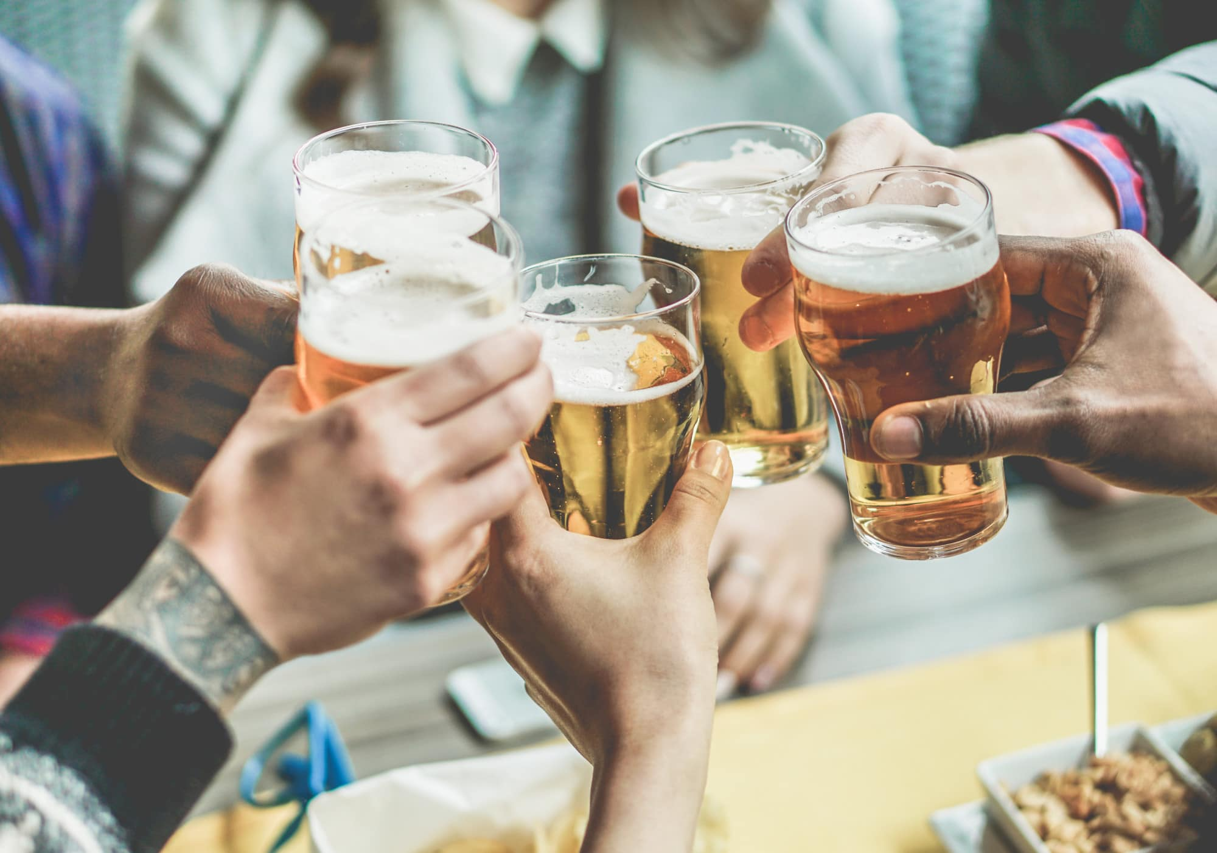



The Team
<- Timothy Malasky
github.com/Tmalasky
<- Jack Moletteire
github.com/jmoletteire
<- Souleymane Ndiaye
github.com/muurid1

Slide 3
Background & Topic Selection
Craft beer is becoming increasing demanded by consumers in today’s market. Consumers’ willingness to spend more on craft beer based on variety, flavor and quality has increased since its beginnings in the 1960s. Craft beer is typically made with higher quality ingredients, which provides consumers with a more flavorful and distinctive tasting beer than mass-produced options. Those reaching for a craft beer often want a variety of flavors and to try new things and that craft brews really help beer not lose more market shares over the last decade. The number of operating craft breweries in the U.S. reached an all-time high in 2021 of 9,118. We have come together as a team to help with the biggest question when it comes to craft beer, "Which one should I get?". We are developing a Beer Recommending system using Kaggle Beer Profile and Ratings Data Set and a machine learning algorithm to recommend a beer just for you based on your taste preferences.

Slide 4
Questions for our Dataset
What style of beer is most popular based on data from consumers?
Which flavor profile is most popular based on the dataset?
What type of beer you might prefer based on your input of type of taste preferences?
Which breweries have the most popular beers based on reviews?

Slide 5

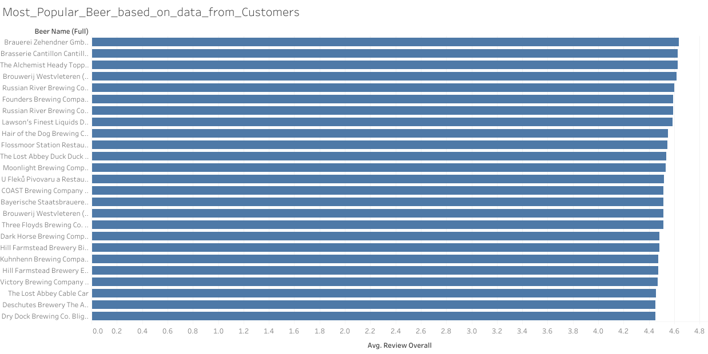

Slide 6
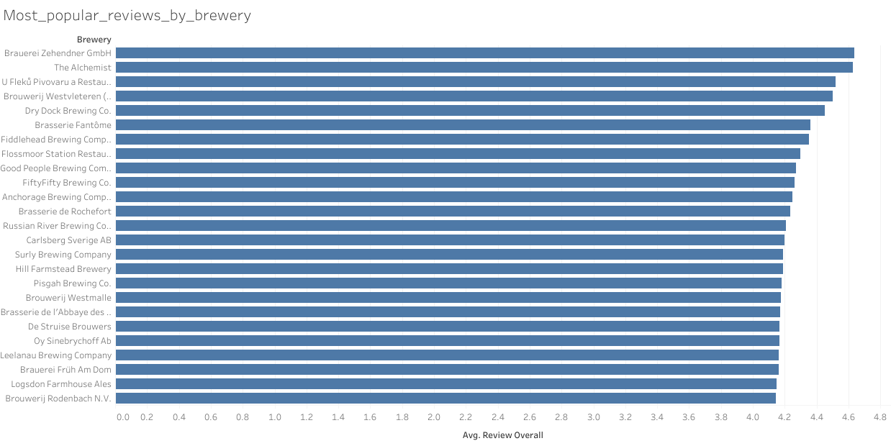

Slide 7
